Slide 1
Orca: A Distributed Serving System for Transformer-Based Generative Models
Gyeong-In Yu, Joo Seong Jeong, Geon-Woo Kim,
Soojeong Kim, Byung-Gon Chun
OSDI 2022
Presenters: Ben Civjan, Sarthak Chakraborty

Slide 2
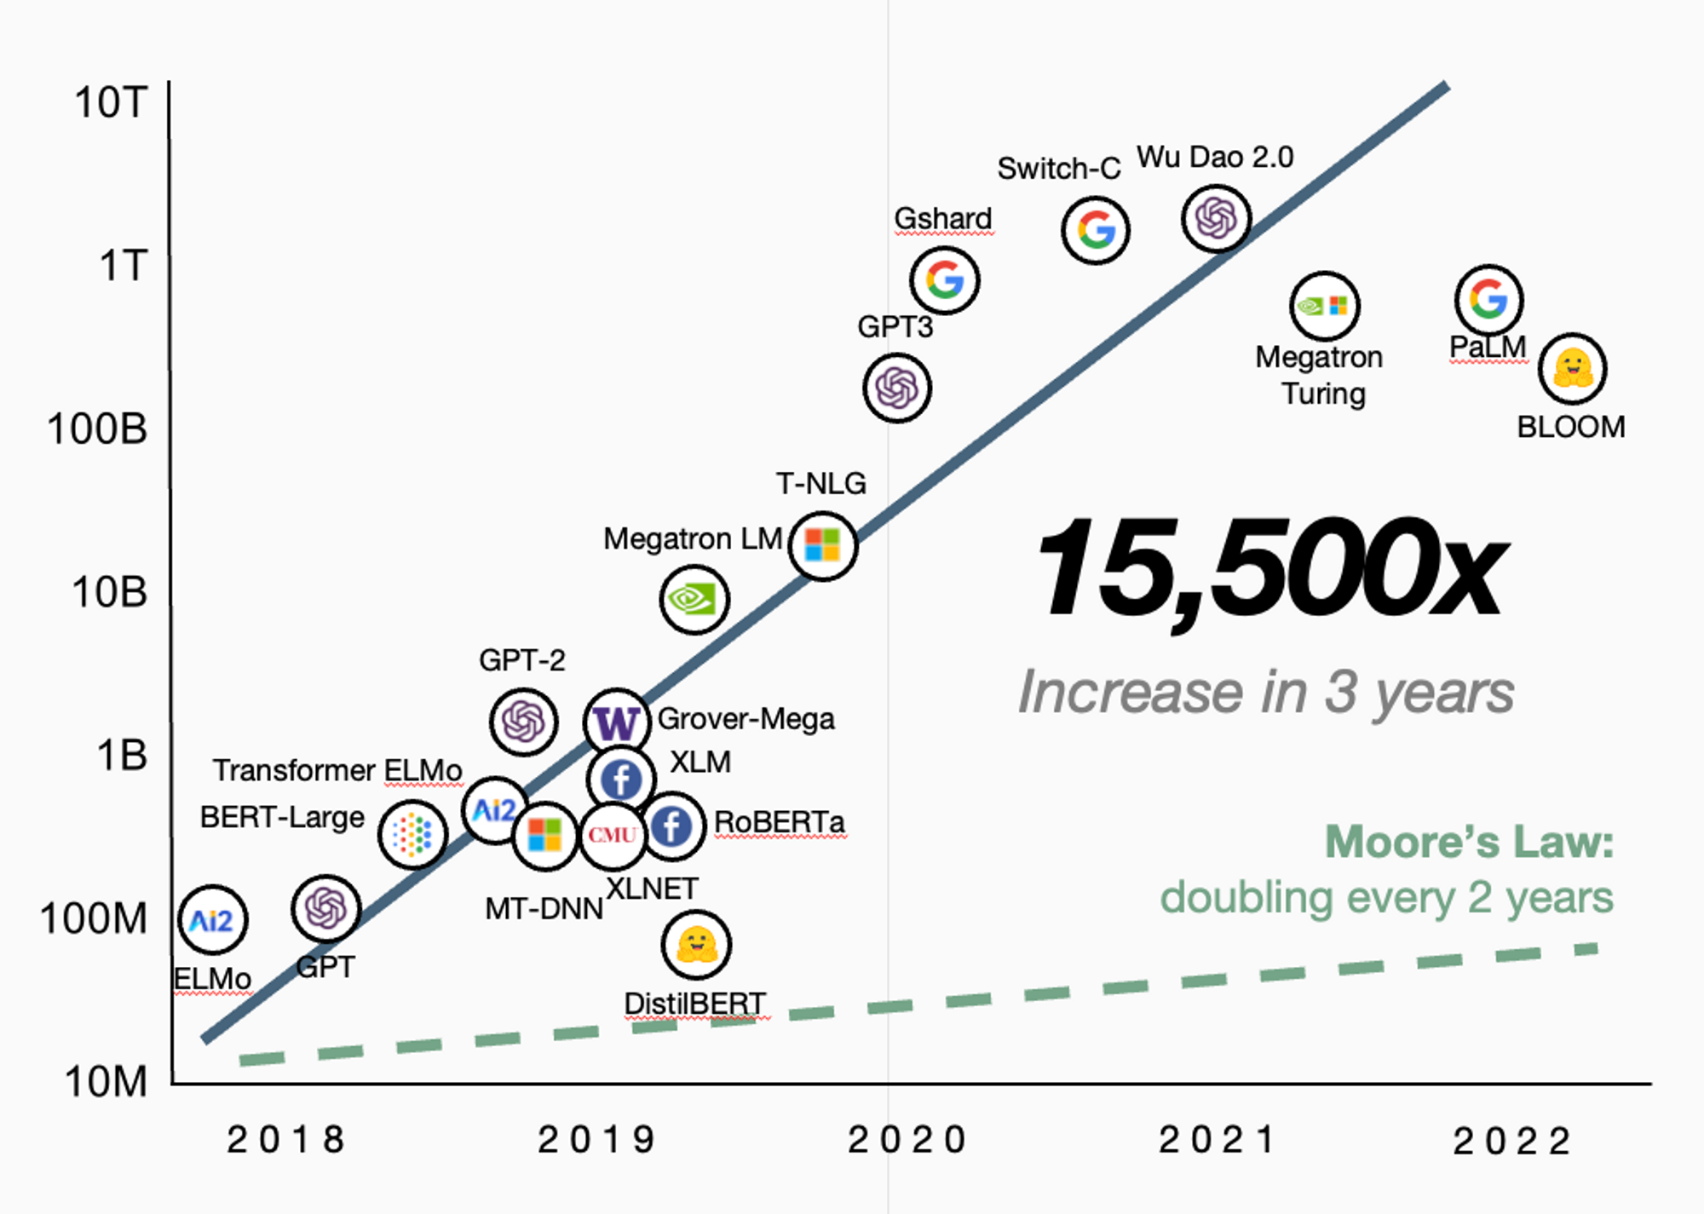
Boom of Generative Models
# Model Parameters
Source: https://www.dingran.me/content/images/2023/04/Screen_Shot_2022-10-16_at_5.59.11_PM--1-.png
Notes:
Generative models have been rapidly developing over the last few years
All of these models are Transformer based
The growth of the number of parameters far exceeds Moore’s Law
Increasingly important to optimize the performance of transformer models

Slide 3
Serving Cost
In Azure, a GPT-3 175B instance requires 2 VMs, each of which has 8 NVIDIA A100 40GB GPUs
At Azure East US, VM price is $27.197/hour 2 VMs = $54.394/hour → $39,707.62/month → $476,491.44/year
Hosting 400 GPT-3 175B instances take $190.6M/year
Slide from official Orca presentation at OSDI’22

Slide 4
Problem Statement
Improve inference serving of “Transformer”-based generative model by reducing the latency of requests and increasing the overall throughput

Slide 5
How Inference works in Generative Language Models
is
great
<EOS>
iter 1
iter 2
iter 3
Layer 3
Layer 3
Layer 3
Layer 2
Layer 2
Layer 2
Prefill Phase
Decode Phase
Decode Phase
Layer 1
Layer 1
Layer 1
I
think
this
is
great

Slide 6
Properties of Generative Language Model Inference
Multi-iteration characteristics
Generates one token at a time
Prefill phase (1st iteration)
Processes all input tokens at once
Builds the KV Cache
Decode phase (2nd - last iterations)
Processes single token generated from last iteration
Uses KV Cache for attention keys and values for all previous tokens

Slide 7
Model Serving System
Inference Server
Execution Engine
requests
Scheduler
response
x1: I think
x2: I love
Model
Request Queue
Maximum Batch Size = 3

Slide 8

Model Serving System
Inference Server
Execution Engine
requests
Scheduler
x1: I think
response
x2: I love
Model
Request Queue
x1: this is great
Maximum Batch Size = 3
x2: you

Slide 9
Model Serving System
Inference Server
Execution Engine
requests
Scheduler
response
Model
x1: I think this is great
Request Queue
X2: I love you
Maximum Batch Size = 3

Slide 10
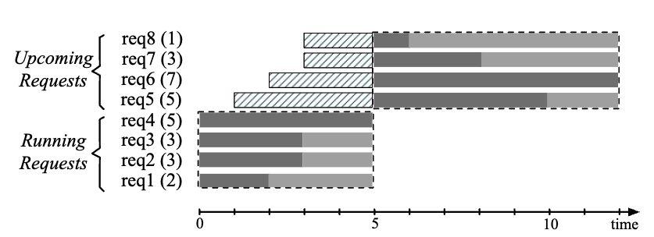
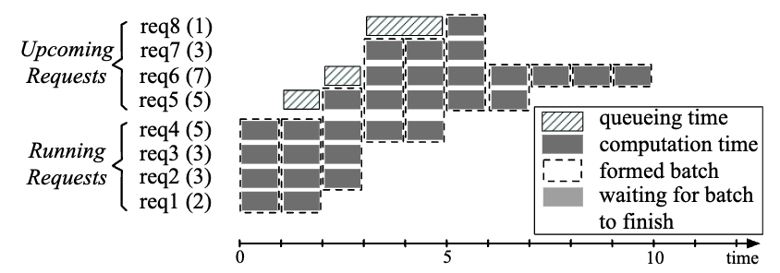
Related Works
BatchMaker (EuroSys ‘18)
Serving system for RNNs at granularity of RNN cells
Breaks dataflow graph into RNN cells, schedules RNN cells, and batches identical cells
Doesn’t generalize well to Transformers – state explosion
Lacks support for model and pipeline parallelism
Previous work on Dataflow Graph Batching
BatchMaker – Cellular Batching

Slide 11
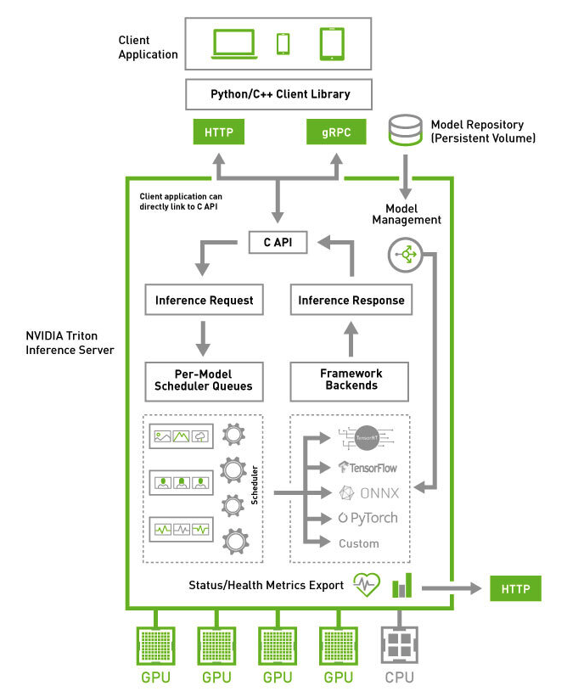
Related Works
Triton Inference Server / TensorFlow Serving
Separates implementation of serving layer and execution layer
Implements scheduling and batching algorithms
Dynamic Batching
Sequence Batching
Allows multiple models to concurrently execute
Supports multiple frameworks
TensorRT
TensorFlow
PyTorch
ONNX

Slide 12
Related Works
FasterTransformer
Faster inference pipeline and supports distributed execution
Highly optimized transformer block for encoder and decoder layers – uses highly optimized libraries like cuBLAS, cuBLASLt, cuSPARSELt for matmul
Fuse multiple operations into one kernel to improve math density and reduce data transfer – 70 kernels are fused to 16 kernels
Replaces some function by a faster but a lower precision counterpart
Receives batch from a batching mechanism and conducts inference procedure

Slide 13
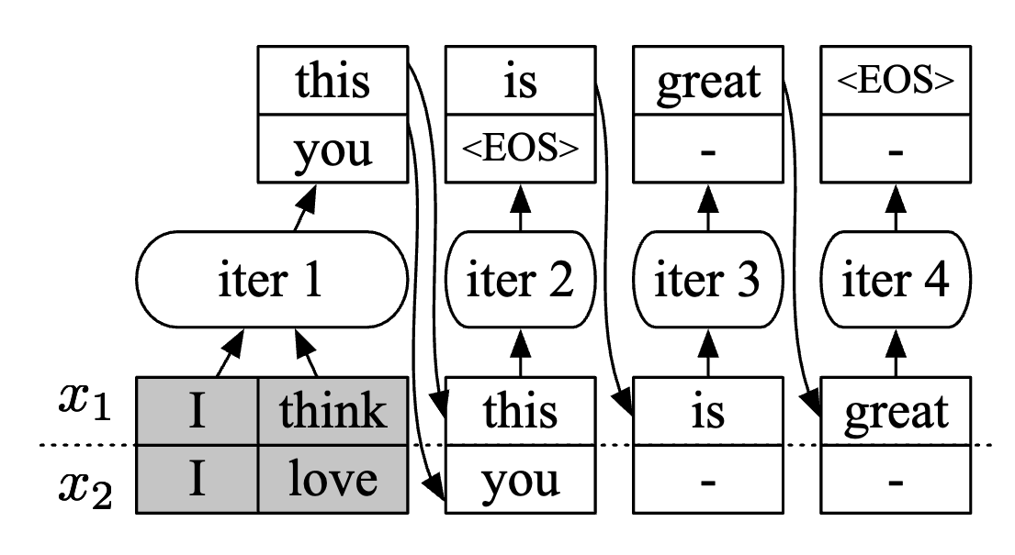
Problem 1: Request Level Scheduling
Execution Engine
x2 generation done
Cannot return to the inf. Server
→
Latency Increase
Early Finished Requests cannot return back
Latency Increases

Slide 14
Problem 1: Request Level Scheduling
Inference Server
Execution Engine
requests
Scheduler
x1: I think
response
New!
x2: I love
x3: A man
Model
Request Queue
Started processing x1 and x2
Maximum Batch Size = 3

Slide 15
Problem 1: Request Level Scheduling
Inference Server
Execution Engine
requests
Scheduler
Late Joining Requests need to wait
Latency Increases
x1: I think
response
New!
x2: I love
x3: A man
Model
Request Queue
Need to wait until return from the engine
→ Latency Increase
Maximum Batch Size = 3

Slide 16
Solution 1: Iteration Level Scheduling
ORCA
Execution Engine
schedule one iter
requests
Scheduler
return
response
select requests
Request Pool

Slide 17
Solution 1: Iteration Level Scheduling
ORCA
Execution Engine
requests
Scheduler
response
select requests
Request Pool
x1: I think
x2: I love

Slide 18
Solution 1: Iteration Level Scheduling
ORCA
Execution Engine
schedule one iter
x1: I think
requests
Scheduler
x2: I love
iter 1
response
Request Pool

Slide 19
Solution 1: Iteration Level Scheduling
ORCA
Execution Engine
requests
Scheduler
return
x1: I think this
response
x2: I love you
Request Pool
x3: A man

Slide 20
Solution 1: Iteration Level Scheduling
ORCA
Execution Engine
requests
Scheduler
response
select requests
Request Pool
x1: I think this
x3: A man
x2: I love you

Slide 21
Solution 1: Iteration Level Scheduling
ORCA
Execution Engine
schedule one iter
x1: I think this
requests
Scheduler
x2: I love you
x3: A man
iter 2
response
Request Pool

Slide 22
Solution 1: Iteration Level Scheduling
ORCA
Execution Engine
requests
Scheduler
return
x1: I think this is
x2: I love you <EOS>
response
x3: A man is
Request Pool

Slide 23
Solution 1: Iteration Level Scheduling
ORCA
Execution Engine
requests
Scheduler
response
select requests
Request Pool
x2: I love you <EOS>
x1: I think this is
x4: How are
x3: A man is
x5: When will

Slide 24
Solution 1: Iteration Level Scheduling
ORCA
Execution Engine
schedule one iter
x1: I think this is
requests
Scheduler
x3: A man is
Iteration Level Scheduling handles early finished requests and late joining requests
x4: How are
iter 3
response
Request Pool
x5: When will

Slide 25
Problem 2: How to Batch requests?
ORCA
Execution Engine
requests
Scheduler
response
select requests
Request Pool
x1: I think this is
x4: How are
Which requests to choose
x3: A man is
x5: When will
(diff number of tokens)

Slide 26
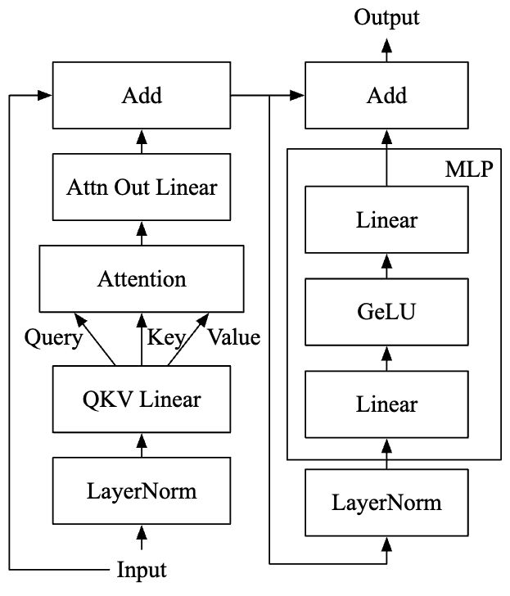
Problem 2: How to Batch requests?
Let’s assume Batch Size B = 1
Input Dimension: [L x H] (L=sequence length, H=hidden dim.)
Attention Operation:
QK^{T} : [LxH] x [HxL] → [L x L]
P = softmax(QK^{T}) : [L x L]
O = PV : [LxL] x [LxH] → [L x H]
With Batch Size B, QK^{T} will be [B x L x L]
With different sequence lengths, QK^{T} cannot be computed

Slide 27
Problem 2: How to Batch requests?
Batching is applicable only when
Requests are in the same phase
Requests have the same number of input tokens (for prefill phase)
Requests have the same token generation index (for decode phase)

Slide 28
Problem 2: How to Batch requests?
Batching is applicable only when
Requests are in the same phase
Requests have the same number of input tokens (for prefill phase)
Requests have the same token generation index (for decode phase)
Query Tensor
x1: I think this is
Decode Phase
x1: 1xH tensor
Cannot be coalesced to form [BxLxH] tensor
x3: A man is
Decode Phase
x3: 1xH tensor
x4: How are
Prefill Phase
x4: 2xH tensor

Slide 29
Problem 2: How to Batch requests?
Batching is applicable only when
Requests are in the same phase
Requests have the same number of input tokens (for prefill phase)
Requests have the same token generation index (for decode phase)
Same argument as previous.
Cannot be coalesced together in [BxLxH] tensor

Slide 30

Problem 2: How to Batch requests?
Batching is applicable only when
Requests are in the same phase
Requests have the same number of input tokens (for prefill phase)
Requests have the same token generation index (for decode phase)
Attention Scores
|x1| = 4
|x2| = 3
|x3| = 2
K_{1,1:4}
K_{2,1:3}
K_{3,1:2}
Cannot be coalesced to form [BxLxH] tensor
x1: I think this is
x2: I love you
x3: A man

Slide 31
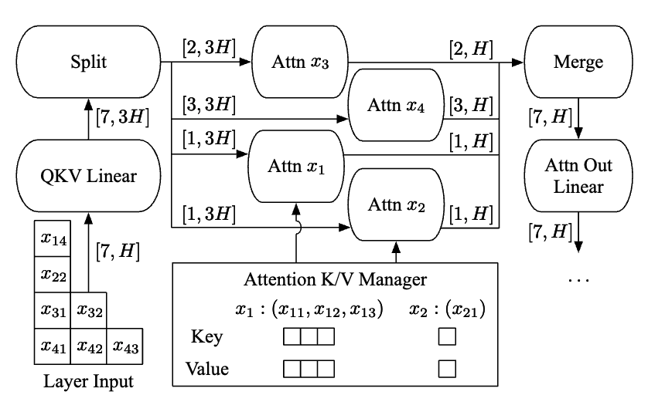
Solution 2: Selective Batching
Only Attention operation does not work with batching tensors with diff. L_{i}
Batch for other ops. (Layer Norm, GeLU, etc.)
Coalesce [L_{i}, H] tensor to [ΣL_{i}, H] for batching
x1: [1,H]
x2: [1,H]
x3: [2,H]
x4: [3,H]
Use flattened 2D tensor without batch dimension
[7,H] tensor

Slide 32
Solution 2: Selective Batching
Split, process each request and merge tensors
Only Attention operation does not work with batching tensors with diff. L_{i}
Batch for other ops. (Layer Norm, GeLU, etc.)
Coalesce [L_{i}, H] tensor to [ΣL_{i}, H] for batching
x1: [1,H]
x2: [1,H]
x3: [2,H]
x4: [3,H]
[7,H] tensor
Notes:
Orca goes one step further than other inference systems and fuses the kernels of the split Attention operators by simply concatenating all thread blocks of the kernels for different requests.

Slide 33
Orca System Overview
ORCA
Execution Engine
schedule one iter
x1: I think
requests
Scheduler
x2: I love
return result
iter 1
select requests
response
Request Pool

Slide 34
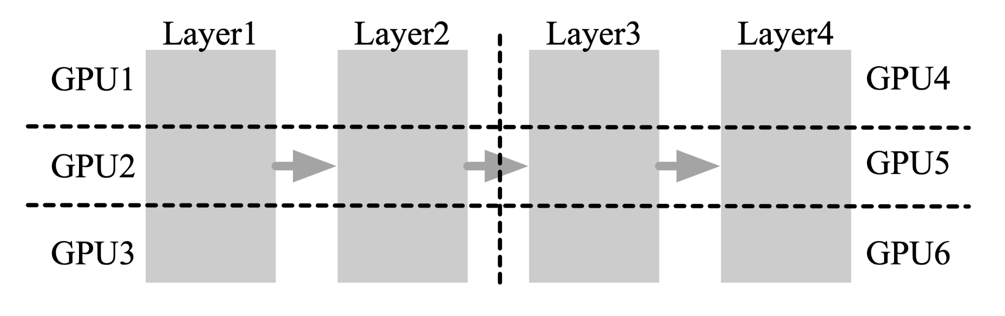
Orca Scaling
Composes intra-layer and inter-layer parallelism
Inter-layer
Intra-layer
Notes:
Intra-layer parallelism splits matrix multiplications (i.e., Linear and Attention operations) and their associated parameters over multiple GPUs
Inter-layer parallelism splits Transformer layers over multiple GPUs. ORCA assigns the same number of Transformer layers to each GPU.

Slide 35
Orca Execution Engine
Intra-layer
Inter-layer
Execution Engine
Worker 1
Worker 3
Control Plane
Control Plane
Controller
Controller
Scheduler
Engine Master
GPU
L1-1
…
GPU
L3-1
GPU
L1-2
GPU
L3-2
GPU
L1-3
GPU
L3-3
Notes:
Each worker process is responsible for an inter-layer partition of the model and can be placed on a different machine from each other.

Slide 36
Orca Execution Engine
Execution Engine
Worker 1
Worker 3
Control Plane
Control Plane
Control Message
Controller
Controller
Scheduler
Engine Master
GPU
L1-1
…
GPU
L3-1
GPU
L1-2
GPU
L3-2
GPU
L1-3
GPU
L3-3
Notes:
Once the engine is scheduled to run an iteration of the model for a batch of requests, the engine master forwards the received information about the scheduled batch to the first worker process
Info includes tokens for current iteration and a control message composed of ids of requests within batch, current token index, and number of input tokens

Slide 37
Orca Execution Engine
Execution Engine
Worker 1
Worker 3
Control Plane
Control Plane
Controller
Controller
Scheduler
Engine Master
GPU
L1-1
…
GPU
L3-1
GPU
L1-2
GPU
L3-2
GPU
L1-3
GPU
L3-3
Notes:
The controller of Worker1 hands over the information received from the engine master to the GPU-controlling threads, where each thread parses the information and issues proper GPU kernels to its associated GPU.
For example, the kernel for the Attention operation uses the request id and the current token index to get the GPU memory address of previous keys and values kept by the Attention K/V manager.
In the meantime, the controller also forwards the control message to the controller of the next worker (Worker2), without waiting for the completion of the kernels issued on the GPUs of Worker1.
To keep GPUs busy as much as possible, we design the ORCA engine to minimize synchronization between the CPU and GPUs. We observe that current systems for distributed inference (e.g., FasterTransformer [4] and Megatron-LM [3]) have CPU-GPU synchronization whenever each process receives control messages5 because they exchange the messages through a GPU-to-GPU communication channel – NCCL [5].
Orca uses gRPC to synchronize, NCCL just for data
Why?

Slide 38
Orca Execution Engine
Execution Engine
Worker 1
Worker 3
Control Plane
Control Plane
Controller
Controller
Scheduler
Engine Master
Tensor Data
GPU
L1-1
…
GPU
L3-1
GPU
L1-2
GPU
L3-2
GPU
L1-3
GPU
L3-3
Notes:
ORCA separates the communication channels for control messages (plus tokens) and tensor data transfer, avoiding the use of NCCL for data used by CPUs.
Figure 7 shows that the ORCA engine uses NCCL exclusively for exchanging intermediate tensor data (represented by dashed arrows) as this data is produced and consumed by GPUs. Control messages, which is used by the CPU threads for issuing GPU kernels, sent between the engine master and worker controllers by a separate communication channel that does not involve GPU such as gRPC

Slide 39
Orca Execution Engine
Execution Engine
Tokens
Control Plane
Control Plane
Controller
Controller
Scheduler
Engine Master
GPU
L1-1
…
GPU
L3-1
GPU
L1-2
GPU
L3-2
GPU
L1-3
GPU
L3-3
Notes:
Unlike Worker1, the controller of the last worker (Worker2) waits for (i.e., synchronize with) the completion of the issued GPU kernels, in order to fetch the output token for each request and send the tokens back to the engine master

Slide 40
Orca System Overview
ORCA
Execution Engine
schedule one iter
x1: I think
requests
Scheduler
x2: I love
return result
iter 1
select requests
response
Request Pool

Slide 41
Scheduler
Enforces iteration-level first-come-first-served (FCFS) property
Maximum batch size → Throughput vs. Latency control knob
Keep track of number of reserved slots to avoid deadlock
Slot := memory required for storing an Attention key and value for a single token
Reserves max_tokens memory slots per request
Notes:
An earlier arrived request will always have executed more iterations than a later request; this does not mean it will always finish earlier
Why deadlock can happen:
A naïve implementation can make the scheduler fall into a deadlock when the scheduler cannot issue an iteration for any requests in the pool because there is no space left for storing a new Attention key and value for the next token. This requires the ORCA scheduler to be aware of the remaining size of pre-allocated memory regions for the manager.
The scheduler uses the request’s max_tokens attribute to reserve max_tokens slots of GPU memory for storing the keys and values in advance
The scheduler determines whether the reservation is possible (line 25) based on n_rsrv, the number of currently reserved slots
n_slots is a parameter tuned by the ORCA system operator indicating the size of memory region (in terms of slots) allocated to the Attention K/V manager

Slide 42
Scheduling Algorithm: Selecting a Batch
Parameters: num workers,
max batch size,
num K/V slots
Scheduler
R1
R2
R3
R4
num slots
Request Pool
Notes:
Unlike the tuning of max_bs that requires quantifying the trade-off between latency and throughput, the ORCA system operator can easily configure n_slots without any experiments. Given a model specification (e.g., hidden size, number of layers, etc.) and degrees of intra- and inter- layer parallelism, ORCA’s GPU memory usage mostly depends on n_slots. That is, the operator can simply use the largest possible n_slots under the memory constraint.

Slide 43
Scheduling Algorithm: Selecting a Batch
Parameters: num workers,
max batch size = 3,
num K/V slots = 10
Scheduler
R1
R2
R3
R4
num slots
Request Pool
Notes:
The max_tokens attribute is a per-request option, meaning the maximum number of tokens that a request can have after processing.

Slide 44
Scheduling Algorithm: Selecting a Batch
Parameters: num workers,
max batch size = 3,
num K/V slots = 10
Scheduler
R2
R1 max tokens = 6
R3
R4
num slots
Request Pool
Notes:
The max_tokens attribute is a per-request option, meaning the maximum number of tokens that a request can have after processing.

Slide 45
Scheduling Algorithm: Selecting a Batch
Parameters: num workers,
max batch size = 3,
num K/V slots = 10
Scheduler
R1 max tokens = 6
R2
max tokens = 3
R3
R4
num slots
Request Pool
Notes:
The max_tokens attribute is a per-request option, meaning the maximum number of tokens that a request can have after processing.

Slide 46
Scheduling Algorithm: Selecting a Batch
Parameters: num workers,
max batch size = 3,
num K/V slots = 10
Scheduler
R1 max tokens = 6
R2
max tokens = 3
R3
max tokens = 2
R4
num slots
Request Pool
Notes:
The max_tokens attribute is a per-request option, meaning the maximum number of tokens that a request can have after processing.

Slide 47
Scheduling Algorithm: Selecting a Batch
Parameters: num workers,
max batch size = 3,
num K/V slots = 10
Scheduler
R1 max tokens = 6
R2
max tokens = 3
R3
max tokens = 2
R4
num slots
Request Pool
Notes:
The max_tokens attribute is a per-request option, meaning the maximum number of tokens that a request can have after processing.

Slide 48
Scheduling Algorithm: Processing Batches
Multiple batches are scheduled across workers
Number of scheduled batches equals number of workers
Workers are always busy, minimal idle time
Smoother, more efficient pipelining without microbatches

Slide 49
Scheduling Algorithm: Processing Batches
Requests:
Requests:
A
B
C
D
E
F
A
B
C
D
E
F
W1
P1
W2
P2
W3
P3
ORCA
FasterTransformer

Slide 50
Scheduling Algorithm: Processing Batches
Requests:
Requests:
C
D
E
F
C
D
E
F
A₁B₁
A₁ B₁
W1
P1
A₁B₁
A₁ B₁
W2
P2
A₁B₁
A₁ B₁
W3
P3
ORCA
FasterTransformer

Slide 51
Scheduling Algorithm: Processing Batches
Requests:
Requests:
E
F
C
D
E
F
A₁B₁
C₁D₁
A₁ B₁
A₂ B₂
W1
P1
A₁B₁
C₁D₁
A₁ B₁
W2
P2
A₁B₁
C₁D₁
A₁ B₁
W3
P3
ORCA
FasterTransformer

Slide 52
Scheduling Algorithm: Processing Batches
Requests:
Requests:
C
D
E
F
A₁B₁
C₁D₁
E₁F₁
A₂B₂
A₁ B₁
A₂ B₂
A₃
W1
P1
A₁B₁
C₁D₁
E₁F₁
A₂B₂
A₁ B₁
A₂ B₂
W2
P2
A₁B₁
C₁D₁
E₁F₁
A₂B₂
A₁ B₁
A₂ B₂
W3
P3
ORCA
FasterTransformer

Slide 53
Scheduling Algorithm: Processing Batches
Requests:
Requests:
C
D
E
F
A₁B₁
C₁D₁
E₁F₁
A₂B₂
C₂D₂
E₂F₂
A₁ B₁
A₂ B₂
A₃
W1
P1
A₁B₁
C₁D₁
E₁F₁
A₂B₂
C₂D₂
A₁ B₁
A₂ B₂
W2
P2
A₁B₁
C₁D₁
E₁F₁
A₂B₂
A₁ B₁
A₂ B₂
W3
P3
ORCA
FasterTransformer

Slide 54
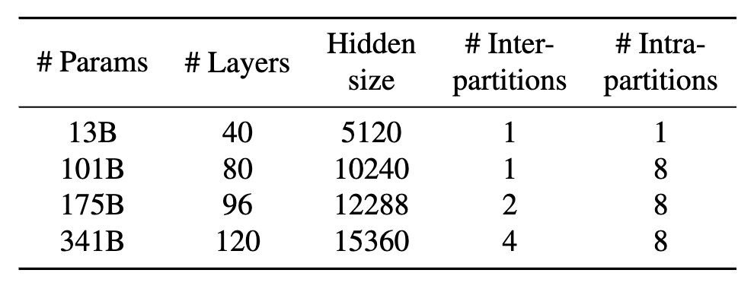
Evaluation Setup
Hardware
Models
Baseline
4 GPT-3 based models
(13B, 101B, 175B, 341B)
Inter and Intra-layer Parallelism applied
Faster Transformer
Optimized inference engine that supports large scale Transformer
models via distributed execution
4 Azure VMs
Each VM has 8 NVIDIA 40GB A100 GPU connected through NVlink

Slide 55
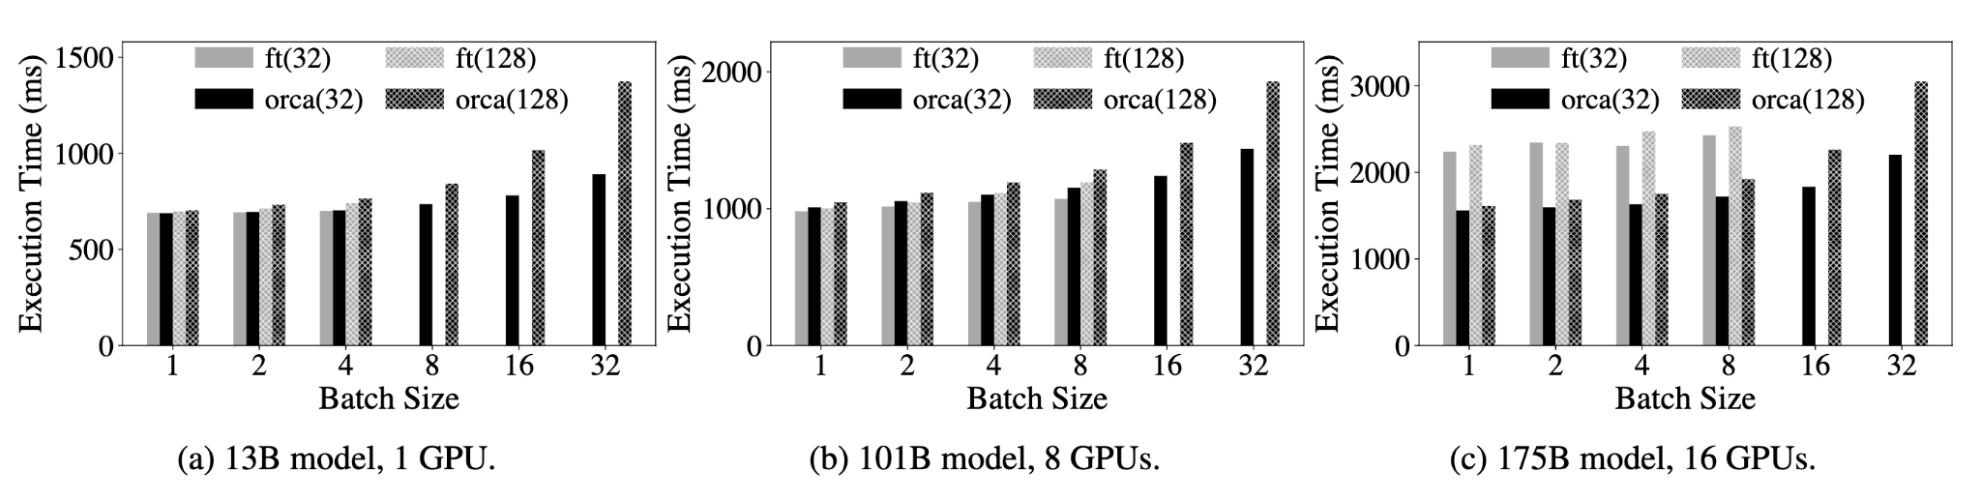
Performance of ORCA Execution Engine
Do not run Scheduler with Orca Engine
Use request level scheduling; wait until all request in the batch finishes
Assumption: Request in a batch have same # input tokens (32 or 128), # output tokens (?)
1 VM
1 VM
Slightly Worse Performance for 13B model
Attention computation not batched
Notes:
Attention does not have model parameters. So no need to reuse model parameters across requests and hence this has little impact on the efficiency
FasterTransformer cannot use a batch size of 8 or larger with the 13B model (16 or larger with the 101B model) because of the fixed amount of memory pre-allocation for each request’s Attention keys and values, which grows in proportion to the max sequence length of the model (2048 for this case).

Slide 56
Performance of ORCA Execution Engine
Do not run Scheduler with Orca Engine
Use request level scheduling; wait until all request in the batch finishes
Assumption: Request in a batch have same # input tokens (32 or 128), # output tokens (?)
1 VM
1 VM
Similar results for 101B model as well
Comparable efficiencies of CUDA kernels
Notes:
ORCA avoids redundant memory allocation by setting the size of buffers for the keys and values separately for each request based on the max_tokens attribute. ????

Slide 57
Performance of ORCA Execution Engine
Do not run Scheduler with Orca Engine
Use request level scheduling; wait until all request in the batch finishes
Assumption: Request in a batch have same # input tokens (32 or 128), # output tokens (?)
2 VMs
Orca outperforms by upto 47%
Improved control-data plane separation
Notes:
Pipelined execution disabled for both the models for better comparison.

Slide 58
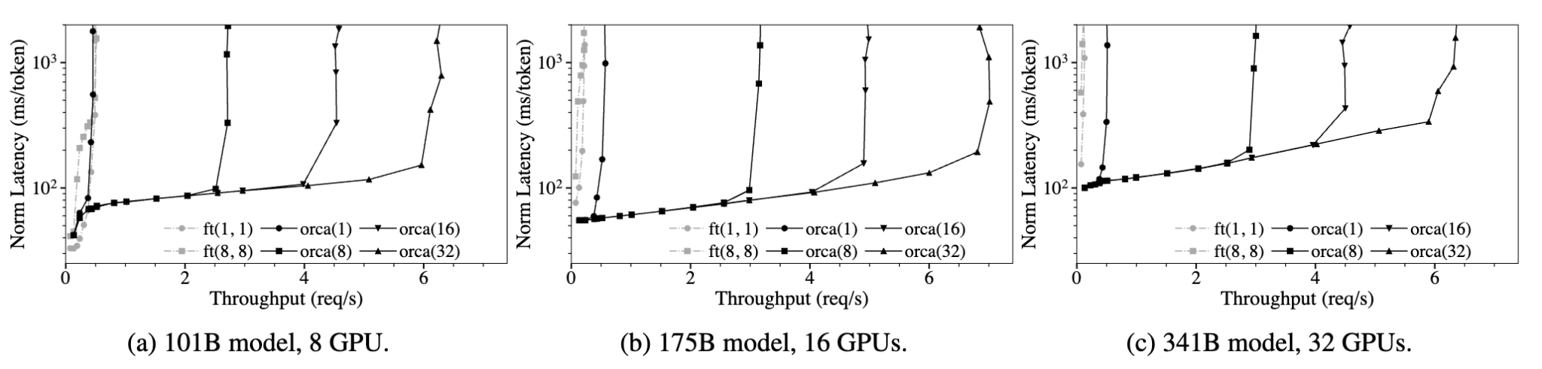
End to End Performance
Max batch size
ft(max_bs, mbs) orca(max_bs)
Request arrival time follows Poisson Distribution
# Input Tokens ~ U(32, 512)
# Output Tokens ~ U(1, 128)
Use custom scheduler used by existing system like Triton for FasterTransformer
Report median latency normalized by the number of generated tokens of each request
Microbatch size
Not enough requests to batch efficiently
~ Engine’s performance
Notes:
Is the scheduler for FasterTransformer FCFS?

Slide 59
End to End Performance
Request arrival time follows Poisson Distribution
# Input Tokens ~ U(32, 512)
# Output Tokens ~ U(1, 128)
Use custom scheduler used by existing system like Triton for FasterTransformer
Report median latency normalized by the number of generated tokens of each request
Higher throughput with small increase in latency due to batching
Notes:
Why the throughput increased for 175B and 341B model where inter layer parallelism is used?

Slide 60
Varying Batch Size Configuration
Max batch size
ft(max_bs, mbs) orca(max_bs)
Increasing batch size improves throughput → early-finished and late-joining requests resolved
Nevertheless, no guarantee it will not negatively affect latency
Large batch size → likelihood of different request in batch → FasterTransformer not efficient
Microbatch size
Notes:
By testing possible combinations of max_bs, mbs in FasterTransformer, (1,1) and (8,8) works the best. Best performance when mbs=max_bs (maximum possible mbs) because of the pipelining strategy

Slide 61
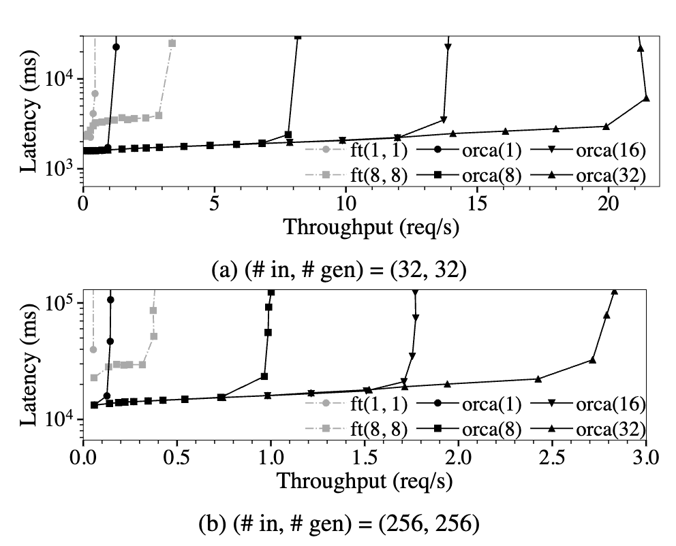
Homogenous Requests
All request lengths are same
No early-leaving request
Noticeable positive impact of higher max_bs on FasterTransformer
orca(1) → no batching
# concurrent request = # workers
Orca outperforms
Better execution engine design
Better pipelining strategy

Slide 62
Thoughts
Strengths
36.9x latency improvement over FasterTransformer
Significantly reduces wait time for new requests
Highly scalable, efficiently distributes batches across parallel workers
Scales more efficiently than FT due to separate communication channels
Weaknesses
Assumes knowledge of max_tokens attribute
Need a redesign of execution engine to support selective batching
Could be difficult to integrate with existing execution engines
Scheduling based on arrival time can cause head of line blocking
Reserves block of GPU memory for KV Cache
Solution: vLLM (uses dynamic paging)
Selective batching affects throughput
Notes:
ORCA separates the communication channels for control messages (plus tokens) and tensor data transfer, avoiding the use of NCCL for data used by CPUs.

Slide 63
Future Directions
Separation of scheduler and execution engine
Adaptive load balancing in scheduler
Figure out which worker is heavily loaded w/ KV cache, distribute requests accordingly
Improve scheduling algorithm for certain use cases
Priority, time-bound, approximate SJF to avoid starvation
Separate prefill and decode phases to run on separate GPUs
DistServe, Sarathi-Serve
Reduce split attention overhead
Pad QK^{T} to longest sequence length to allow for attention batching
Notes:
Approximate SJF, Stoica group paper

Slide 64
References
Yu, G.-I., Jeong, J. S., Kim, G.-W., Kim, S., & Chun, B.-G. (2022, July). Orca: A Distributed Serving System for Transformer-Based Generative Models. 16th USENIX Symposium on Operating Systems Design and Implementation (OSDI 22), 521–538. Retrieved from https://www.usenix.org/conference/osdi22/presentation/yu
Slide 3 Image: https://www.dingran.me/content/images/2023/04/Screen_Shot_2022-10-16_at_5.59.11_PM--1-.png

